Slide 1
MRCGP
Applied Knowledge Test
Prepared by the AKT Core Group
February 2025
Notes:
1

Slide 2
Objectives
An overview of the content and structure
To give examples of current question formats
To describe how questions are constructed
To advise on how to prepare and pass the AKT
To explain practicalities of computer-based tests

Slide 3
AKT Background
The AKT:
  Is a summative assessment of the knowledge base underpinning independent UK general practice
  Tests the application of this knowledge
  Tests the critical interpretation of information
  Is mapped to the latest RCGP Curriculum updates
Each question is intended to explore a topic which GPs across the UK should be expected to have a working knowledge of

Slide 4
Format
200-item multiple-choice test lasting 190 minutes (3 hours 10 minutes)*
  No multiple true/false questions
  No negative marking
Delivered on a computer terminal* at an invigilated test centre
Offered four times a year:
Jan/Feb, April/May, July, Oct/Nov
* Please see slide 53 and the RCGP website for information on reasonable adjustments

Slide 5
Rules
Only trainees in the ST2 and ST3 stages of training are eligible to take the AKT.
In accordance with GMC guidance* an AKT pass is valid for seven years.
GP Registrars in training (includes TGPT, LTFT, on Maternity Leave) in ST2/3 between 18 March 2020 and 3 August 2021 whose ability to study for and take the exam was affected by COVID-19 have the currency of their AKT extended to 7 years and 6 months.
* https://www.gmc-uk.org/education/postgraduate/9813.asp#Currency

Slide 6
Rules: numbers of attempts
For GP Registrars who enter GP Speciality training for the first time on or after 2 August 2023:
All such trainees are allowed a maximum of six attempts
For GP Registrars already in training on 1 August 2023:
Four attempts are allowed in the AKT but:
due to COVID-19, a single unsuccessful attempt at either the July or August 2020 AKT did not count towards the total number of permitted attempts.
Trainees who have support of their deanery and additional educational attainment can apply for an exceptional fifth attempt at the AKT. They must have passed the CSA, SCA, or RCA. For further information: https://www.rcgp.org.uk/training-exams/mrcgp-exam-overview.aspx

Slide 7
Vital Statistics – Feb 2025
  AKT 55 pass mark = 139/200 (69.5%)
  Overall pass rate = 71.4%
  UK graduates first-time takers pass rate = 86.1%
  (Pass rates vary in different diets of the AKT taken at
  different times throughout the training year)
  The cumulative pass rate for all those who take the AKT is at least 95%
Notes:
7

Slide 8
Vital Statistics – Feb 2025
  Overall mean score = 148.5 (74.2%)
  Mean scores by subject area:
Subject area | Mean score (%) | No. of questions
Clinical knowledge | 75.3 | 160
Evidence-based practice | 65.2 | 20
Organisation and management | 75.1 | 20
Notes:
8

Slide 9
Topics causing most difficulty for candidates in AKT 54
Professional topics:
Improving Quality, Safety and Prescribing
  Monitoring commonly prescribed long-term medications
Leadership and management:
  Access to medical records
Life stages topics:
Maternity and reproductive health
  Early pregnancy complications
Clinical topics:
  Neurodevelopmental disorders: presentation of genetic conditions
  Eye signs
  Treatment of common dermatological problems
Notes:
9

Slide 10
Topics causing most difficulty for candidates in AKT 53
Professional topics:
Improving Quality, Safety and Prescribing
  Prescribing for elderly people
  Interpreting investigation results
Clinical topics:
  Causes of common neurological symptoms
  Diagnosis and management of common colorectal/ perianal conditions
  HRT, especially endometrial protection
  Long-term musculoskeletal problems: diagnosis, investigation and management
  Management of asthma
Notes:
10

Slide 11
Topics causing most difficulty for candidates in AKT 52
Professional topics:
Improving Quality, Safety and Prescribing
  Side-effects of commonly prescribed medications
Leadership and management
  Ethics of capacity to consent
Population and planetary health
  Environmentally sustainable medication choices
Life stages topics:
Children and Young People
  Safeguarding
  Normal findings and identifying minor illness in childhood
Clinical topics:
  Issues for generalists in substance misuse
  Management of long-term musculoskeletal problems
  Management of migraine
  Type1/ type2 diabetes differences: diagnosis, investigation, treatment, emergencies
Notes:
11

Slide 12
Topics causing most difficulty for candidates in AKT 51
Professional topics:
Leadership and management:
  Death administration and involving the coroner/ procurator fiscal
Life stages topics:
Children and Young People
  Serious illness in neonates
  People with long term conditions including cancer
  Familiarity with guidance on hypertension including when not to treat
  People at the end of life
  Symptom control in palliative care
Clinical topics:
  Common dermatological problems
  Causes of neurological symptoms
Notes:
12

Slide 13
Summary of ‘professional topics’ causing most difficulty in recent AKT exams
Consulting in General Practice:
    Communication of risk and use of risk tools
Evidence-based practice, Research and Sharing Knowledge:
    Basic understanding of concepts and terms in research (e.g. absolute and relative risk)
    Data interpretation (both research and other data sources)
    Research methodology
Improving Quality, Safety and Prescribing:
    Antibiotic indications, guidance, and resistance
    Drugs: monitoring; adverse reactions; interactions; (dose calculations)*; end-of-life care
    Pathology results, especially borderline and abnormal parameters
Leadership and management:
    Confidentiality* and privacy (including social media and digital technologies)
    Death certification and notifications to Coroner/ Procurator fiscal
    Staff health, and health and safety in the workplace
  Life stages topics:
    Children and Young People including consent and capacity; developmental assessment and screening; safeguarding and non-accidental injury
    People at the End-of-Life including ethics and mental capacity
  * Recently improved (AKT 50-54)
Notes:
13

Slide 14
Summary of clinical topics causing most difficulty in recent AKT exams
Clinical topics:
    Asthma, COPD and rarer respiratory diagnoses; interpreting lung function tests
    Cardiovascular health including: diagnosis, ECG interpretation; reducing risk
    Common gynaecological problems incl. investigations, timely pregnancy testing
    Contraception (incl. use with teratogenic drugs) and HRT
    Dermatology: diagnosis and treatment
    Diagnosis of common oral conditions
    Different presentations of multi-system disease
    Eye and eyelid problems
    Mental health – presentations with physical symptoms; substance abuse*
    Neurological diagnosis, red flags, and interpretation of examination findings
    Normal findings, minor illness, and infections in childhood
    Prescribing in diabetes, including insulin
    Suspected cancer: diagnosis & investigation (including less common presentations)
    Timely but appropriate referral (including emergencies and when to do nothing)
A Five-year summary is also available on the AKT website
Notes:
14

Slide 15
Question writing (1)
Topical
Practice issues
Scenarios derived from clinical work

Slide 16
Question writing (2)
All questions are referenced and the draft questions are then carefully scrutinised by a panel of experienced question writers
Care is taken to consider any conflict between national guidance and regulations across the four devolved nations
Remember that all question writers are working GPs

Slide 17
Important Reference Material (1)
GMC Good Medical Practice
NICE guidelines
SIGN guidelines
CKS (NICE clinical knowledge summaries) if topics not already covered by above guidance
Immunisation against infectious disease (gov.uk) ‘The Green Book’
The AKT does not test on local guidance
The AKT does not prioritise one national guideline over another, but can explore significant differences

Slide 18
Important Reference Material (2)
BNF – including the initial ‘generic’ chapters in the print version
A review has highlighted that up to 27% of AKT questions require a knowledge of therapeutics
For example, although items might appear to be about a respiratory, cardiovascular or endocrine issue, the management will often involve recommending the correct medication – also requiring an awareness of the potential for interactions and monitoring requirements

Slide 19
GP Curriculum
Where to find
https://www.rcgp.org.uk/training-exams/training/gp-curriculum-overview.aspx
Curriculum summaries (can be very useful to identify learning needs):
https://www.rcgp.org.uk/mrcgp-exams/gp-curriculum/super-condensed-guides
How the AKT links to the curriculum
Questions in the AKT sample across the breadth of the curriculum
The previous ‘AKT Content Guide’ has been subsumed within the GP Curriculum and details can be found in the Knowledge and Skills subsections of each Topic Guide

Slide 20
GP Curriculum
How to use the GP Curriculum
Don’t be put off by the lengthy list of topics!
Use the topic guides as needs assessment tools
Carefully review the sections relevant to:
  Leadership and management – including administrative, statutory, ethical and regulatory frameworks
  Evidence based practice, research and sharing knowledge – including statistics and epidemiology

Slide 21
Different clinical experiences
Some candidates may be more familiar or experienced with some areas of the GP curriculum than others. This may due to differences in undergraduate or postgraduate training both within and outside of the UK. It may also be due to exposure in their personal lives.
Some examples:
Parents: Child health
Overseas training: Management of infections
UK training: NHS organisation

Slide 22
Different clinical experiences
Increasingly tasks are delegated to other members of the medical team. Candidates may be less exposed to clinical areas where delegation is common.
Some examples:
Chronic disease monitoring: Nursing teams
Eye problems : Opticians
Elderly care: Care home visiting teams
The curriculum covers all of our responsibilities as GPs. We encourage candidates to assess their knowledge, to identify gaps, and to discuss these with their trainers.

Slide 23
MRCGP AKT Exam website
Please look carefully at our website
https://www.rcgp.org.uk/training-exams/mrcgp-exam-overview/mrcgp-applied-knowledge-test-akt.aspx
The ‘How to prepare for the AKT’ section contains helpful resources, including:
  ‘Preparing to take the AKT’
  50 AKT Sample questions with answers
  How trainers can help with AKT preparation
  Data interpretation in the AKT
  Data interpretation video series
  AKT FAQs
  Re-sitting the AKT
The section ‘AKT Feedback Reports’ contains specific feedback on previous exams and should help guide your revision plans

Slide 24
Exam Construction ensures:
Reliability, validity, and fairness
Adequate coverage of the topics that appear in the blueprint
The correct balance of question formats

Slide 25
Principles of exam construction
Relevance: the AKT should be relevant to general practice
High prevalence: any topic covered can be one which occurs commonly
High impact: any topic covered can be one that is significant but less common

Slide 26
AKT content
  80% of questions
  Core clinical medicine and its application to problem solving in a general practice context
10% of questions
  Data interpretation, critical appraisal, and evidence based clinical practice
10% of questions
  Ethical and legal issues as well as the organisational structures that support UK general practice

Slide 27
Clinical Medicine (1)
The broad topic of clinical medicine is subdivided into groups of body systems, in approximately equal numbers
Each group will comprise questions on:
  disease factors
  symptoms
  investigation
  management

Slide 28
Clinical Medicine (2)
  Cardiovascular
  Dermatology
  Endocrinology
  ENT
  Gastroenterology
  Genetics
  Haematology
  Immunology
  Infection
  Mental health & learning disability
  Musculo-skeletal
  Neurology
  Ophthalmology
  Paediatrics
  Renal
  Reproductive male/female
  Respiratory
  Therapeutic indications and adverse reactions

Slide 29
Clinical Medicine (3)
Common, (mostly) low impact – e.g. sore throat, contraception, irritable bowel syndrome
Rare, high impact – e.g. child abuse, meningitis, phaeochromocytoma
Topical – e.g. changing guidance, optimum use of antibiotics, safe prescribing
Notes:
29

Slide 30
Critical appraisal and evidence-based clinical practice
Understanding the application of critical appraisal skills which will be tested in several formats including:
  interpretation of data commonly seen by GPs, including methods and results from published research
  understanding of common terms used in both evidence-based medicine and statistics
  understanding epidemiology relevant to general practice
Understanding the principles of audit and its application in assessing the quality of care

Slide 31
Critical appraisal and evidence based clinical practice
We use a range of resources to test data interpretation, including the types of graphs and tables regularly sent to practices from local health service organisations and health boards.
We would encourage you to use the following AKT Group tutorial worksheet:
Data interpretation and the AKT
There are video tutorials by Prof Mike Harris:
Interpreting diagnostic test statistics
Interpreting risk
How to interpret the results of a randomised controlled trial

Slide 32
Ethical, Legal & Organisational
These questions are written to be applicable UK-wide
  Appropriate resource use e.g. investigations
  Ethical e.g. Mental capacity, consent
  Health & Safety e.g. needlestick injury
  Leadership e.g. probity, record keeping
  Legal aspects e.g. significant DVLA advice
  Medical certification e.g. death certificates
  Prescribing e.g. Controlled drugs
  Professional regulation, e.g. GMC
  Social services e.g. safeguarding*
* https://www.rcgp.org.uk/learning-resources/safeguarding-standards#4-The-role-of-GPs-and-general-practice-in-safeguar
Notes:
Content Guide Chapter +++

Slide 33
Question Formats
Single Best Answer (SBA)
Multiple Best Answer (MBA)
Extended Matching Questions (EMQ)
Photographic image
Data interpretation
Free text
Drug calculation

Slide 34
Single Best Answer (SBA)
“According to national guidelines” means recommended by nationally accepted guidelines or the BNF, not local practice
Often use a clinical scenario
Only one answer is correct
Other incorrect options may be plausible but not “most likely/most appropriate”

Slide 35
SBA example: Respiratory disease
A 41-year-old man has a chronic cough and is producing green sputum daily. He has a history of recurrent chest infections in childhood.
Which is the single most likely diagnosis? Select one option only.
A. Asthma
B. Bronchiectasis
C. Chronic obstructive pulmonary disease
D. Gastro-oesophageal reflux
E. Lung cancer

Slide 36
Multiple Best Answer (MBA)
Often uses a clinical scenario
Two answers are correct
Both answers must be chosen to score one mark
Other options may be plausible but not the “most likely/most appropriate”

Slide 37
MBA example: Helicobacter pylori
A 35-year-old man has persistent dyspepsia. A stool test for Helicobacter pylori is positive. He has not yet received any antibiotic treatment and is allergic to penicillin.
According to current national guidance, which are the two most appropriate first-line antibiotics to combine with omeprazole to eradicate H.pylori? Select two options only and both must be correct to score one mark.
(See next slide)

Slide 38
MBA example: Helicobacter pylori
Amoxicillin
Cefalexin
Clarithromycin
Co-amoxiclav
Doxycycline
Erythromycin
Lymecycline
Metronidazole

Slide 39
Extended matching questions (EMQ)
These questions have a list of possible options
There will usually be two or more scenarios
Choose the most likely/most appropriate option that best matches each given scenario
Each option can be used once, more than once, or not at all

Slide 40
EMQ example: Dietary advice
Elemental diet
FODMAP
Food elimination
Gluten-free
High fibre
Lactose-free
Low purine
Mediterranean
For the patient described, select the most appropriate diet from the list of options.
1. A 23-year-old woman has had mild diarrhoea, abdominal pain and bloating for several years. Her bloods are normal, including IgA anti-tTG antibodies test.

Slide 41
EMQ example: Dietary advice
Elemental diet
FODMAP
Food elimination
Gluten-free
High fibre
Lactose-free
Low purine
Mediterranean
For the patient described, select the most appropriate diet from the list of options.
2. A 62-year-old man has recurrent swelling of his great toe which responds to naproxen. He drinks 18 units of alcohol a week and his urate level is 540 μmol/L (Normal < 450 μmol/L).

Slide 42
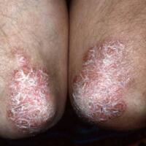
Picture Format example:
Skin disease
A 32-year-old man has a rash affecting both elbows.
He is using a topical emollient regularly.
pcds.org.uk

Slide 43
Picture Format example:
Skin disease
According to current guidance, in addition to emollients, which is the single most appropriate initial topical treatment? Select one option only.
Calcipotriol + betamethasone
Calcitriol
C. Fusidic acid + hydrocortisone
Mometasone furoate
E. Tacrolimus

Slide 44
Data Interpretation
Interpretation of data, e.g for groups of patients with chronic conditions
Interpretation of research and audit results
Understanding and application of common statistical terms, e.g number needed to treat (NNT) and absolute or relative risk

Slide 45
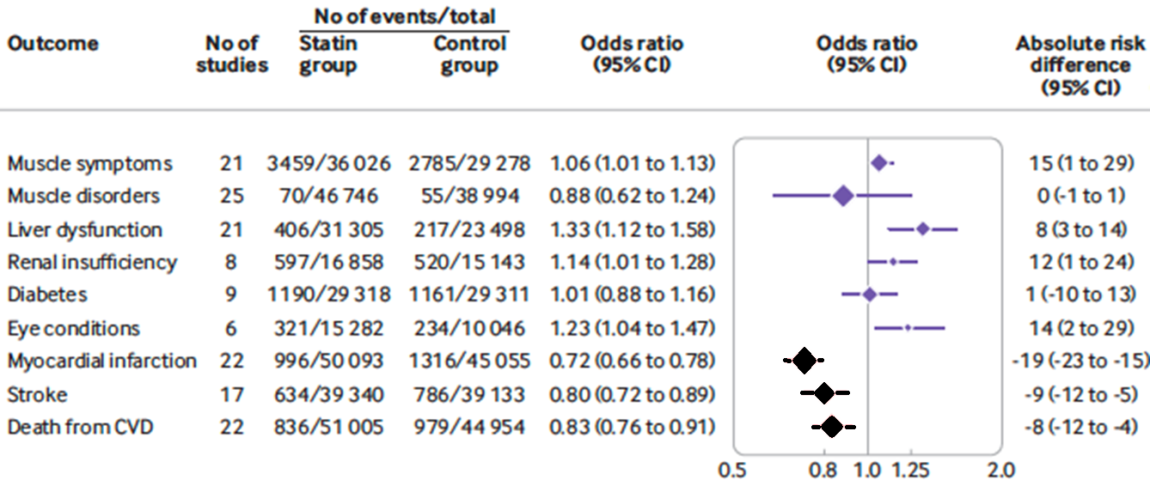
Data Interpretation example
Statins
The figure shows a meta-analysis of safety and efficacy outcomes for statins in the primary prevention of cardiovascular disease (CVD).
BMJ 2021;374:n1537 Fig 3

Slide 46
Data Interpretation example
Statins
According to the data shown, which is the single most accurate statistical description of the effects of statins? Select one option only.
A. Increased risk of diabetes
B. Increased risk of muscle disorders
C. Increased risk of stroke
D. Reduced risk of death from CVD
E. Reduced risk of liver dysfunction
Notes:
46

Slide 47
Free text questions
Require the candidate to generate the correct answer without a list of options to choose from
For example:
  dose calculation
  name of first-line medication
Eliminates guessing from a list of answers
All answers are screened manually to check for minor typographical errors which may be counted as correct.
Candidates will be expected to spell drug names correctly
Notes:
47

Slide 48
Free text example
A 67-year-old man has type 2 diabetes and a BMI of 33 kg/m². His HbA_{1c} is 62 mmol/mol on diet alone and his renal function is normal.
Which is the single most appropriate initial drug treatment? Give one answer only.
Notes:
48

Slide 49
Free text questions - numerical
An on-screen calculator is available
Any arithmetic required in an AKT question (e.g. drug dose calculations) is basic and simple and most candidates do not need to use it
Remember to check that your given answer is credible!
Notes:
49

Slide 50
Calculation example
A 3-year-old boy is to start prophylactic trimethoprim 2 mg/kg once every night. He weighs 12.5 kg and trimethoprim oral suspension is available as 50 mg/ 5ml.
What volume of liquid is required for thirty days use?
Type your answer in the following text box. Use figures
not words. Percentages and fractions are not acceptable.
mls
Notes:
50

Slide 51
Scoring
All question formats have equal weighting
Each correctly answered question is awarded one mark
Total score on the paper is the number of correct answers given
No negative marking – it is important to answer all the questions
Notes:
51

Slide 52
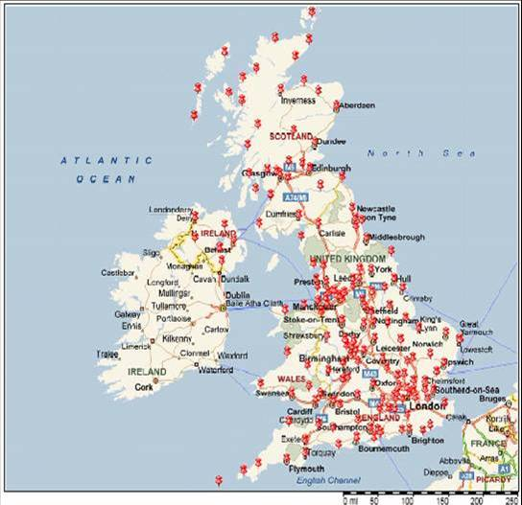
Computer Based Testing
Once candidates have applied via the RCGP website to sit the AKT, they are then directed to the Pearson VUE website to make their test centre booking.
There is a limited booking window with ‘first come, first serve’ choice of test session and venue.
There are approximately 150 test
centres covering all parts of the UK.
Notes:
52

Slide 53

Computer Based Testing Rules
Candidates must bring identity documents which match exactly their application details (see next slide)
Candidates should arrive in good time
Candidates who either arrive late or fail to provide matching ID, will not be admitted to sit the AKT

Slide 54
Identification documents to take to the test centre
  You need to take two documents.
  Both must be originals (not copies) and currently valid:
:
A primary ID
  Your primary ID must be government issued, and include your name, recent recognisable photo and signature (e.g. passport, photo driving licence)
A secondary ID
  Any ID containing at least a name and signature (e.g. credit and debit cards) or a name and recent recognisable photo that follows the ID requirements
  https://home.pearsonvue.com/Policies/1S/English
Notes:
54

Slide 55
Matching names on documents
The first and last name shown on both of your identification documents must match exactly the names you used when submitting your application to the RCGP.
If the names are different:
  For example, if one is your maiden name and one your married name then you must also bring an original official document that links the two names (e.g. a marriage certificate).
If in doubt:
  You must contact the RCGP well before the exam date.
Notes:
55

Slide 56
Reasonable adjustments (RA)
The RCGP has a duty to ensure equality and fairness to candidates and patients
If you have a disability or specific need which requires an adjustment to your exam, please consult the MRCGP RA page of the RCGP website for further information in the first instance
All requests for adjustments should be submitted by the deadline defined on the RA page of the RCGP website. Requests can be submitted early, as soon as you start training, or after a new diagnosis.
To aid the RCGP in providing your approved reasonable adjustment, early booking is recommended (separate individual test rooms are limited)
Please note that approved additional time is added to afternoon sessions. Any recommended rest breaks are included in this time, so the timings of breaks need to be carefully managed by candidates
Notes:
56

Slide 57

Computer Based Testing
Security at each centre will be robust:
  Identity checks
  Invigilated
  Video monitoring
Separate morning and afternoon sittings with a ‘quarantine’ period at lunchtime.
Morning candidates will not be allowed to leave before the end of the test

Slide 58
Computer Based Testing
It is strongly recommended that candidates familiarise themselves with the RCGP Sample Exam on the Pearson VUE website
  http://www.pearsonvue.com/rcgp/
Every AKT will begin with a short tutorial to remind candidates how to select answers and ‘mark’ questions – screen shots follow of the live tutorial
Notes:
58

Slide 59
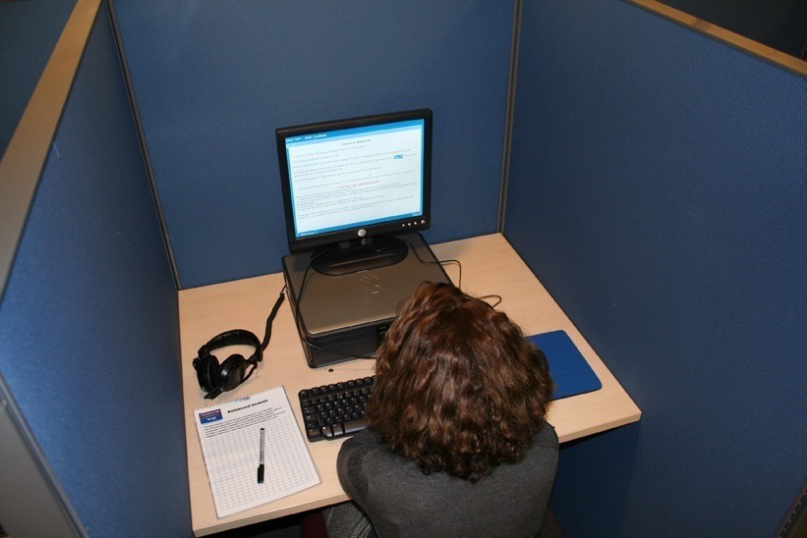
Computer Based Testing
Responses will be uploaded to a central server and then passed to the RCGP for post-test analysis

Slide 60

Computer Based Testing
Results and feedback will be sent individually to the candidate’s ePortfolio and will be available by the end of the day on the published results date

Slide 61
Feedback to candidates
The following feedback will be provided to every candidate with their result
  Their overall score
  The pass mark
  Their performance in each of the three main subject areas
  The mean performance of the cohort overall and in each of the three main subject areas

Slide 62
AKT Feedback Reports
More general feedback on overall performance will continue to be forwarded to all UK deaneries/LETBs and saved on the RCGP website
It is helpful to look at these individual feedback reports and the Five-year summary report to identify topics which commonly cause difficulty:
  https://www.rcgp.org.uk/training-exams/mrcgp-exam-overview/mrcgp-applied-knowledge-test-akt.aspx

Slide 63
AKT tutorial
At the test centre, before starting an AKT exam, all candidates have to complete a 10-minute Pearson VUE tutorial comprising example clinical questions.
These are not part of the exam and are not marked
The following slides show example screenshots from the pre-exam Tutorial, but this can be viewed in advance, in its entirety, from a link on the AKT exam webpages

Slide 64
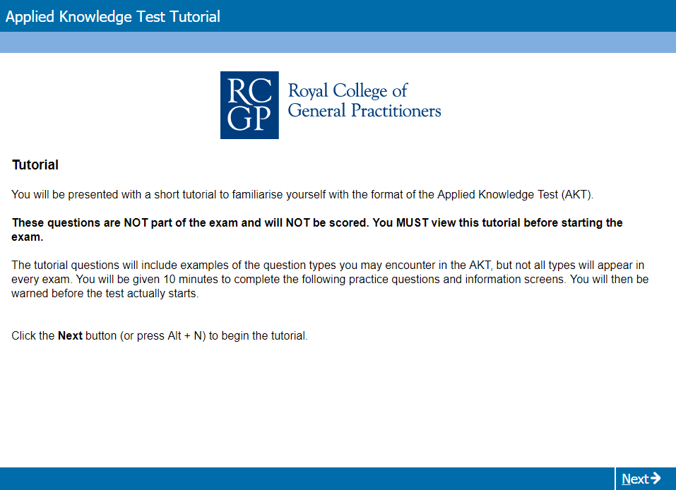
Online AKT Tutorial
Notes:
64

Slide 65
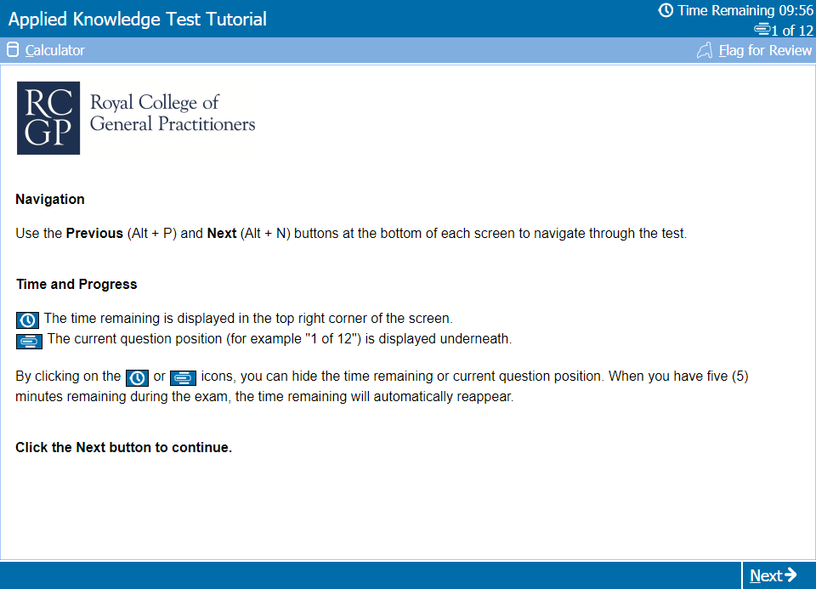
Test Day Tutorial: Opening Screen

Slide 66
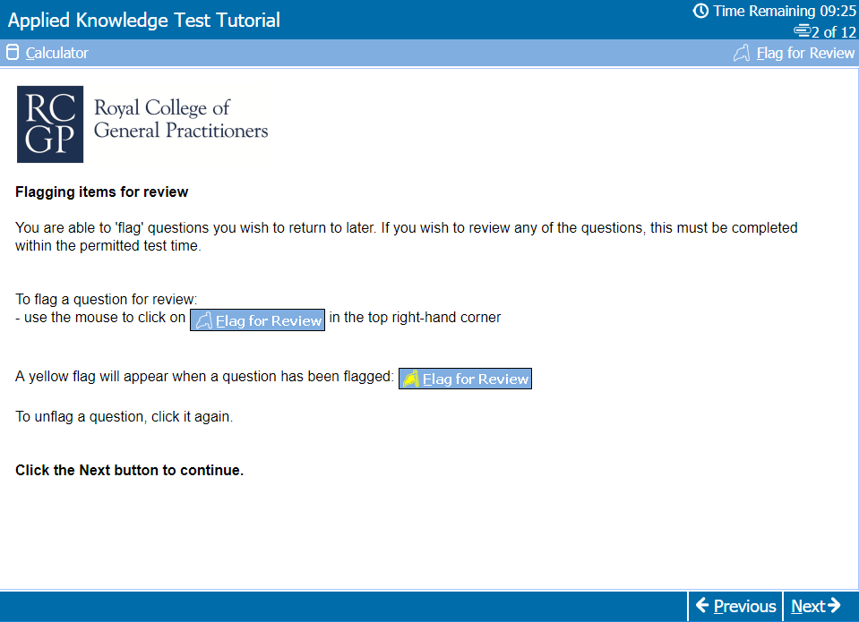
Test Day Tutorial:
Flagging questions for later review

Slide 67
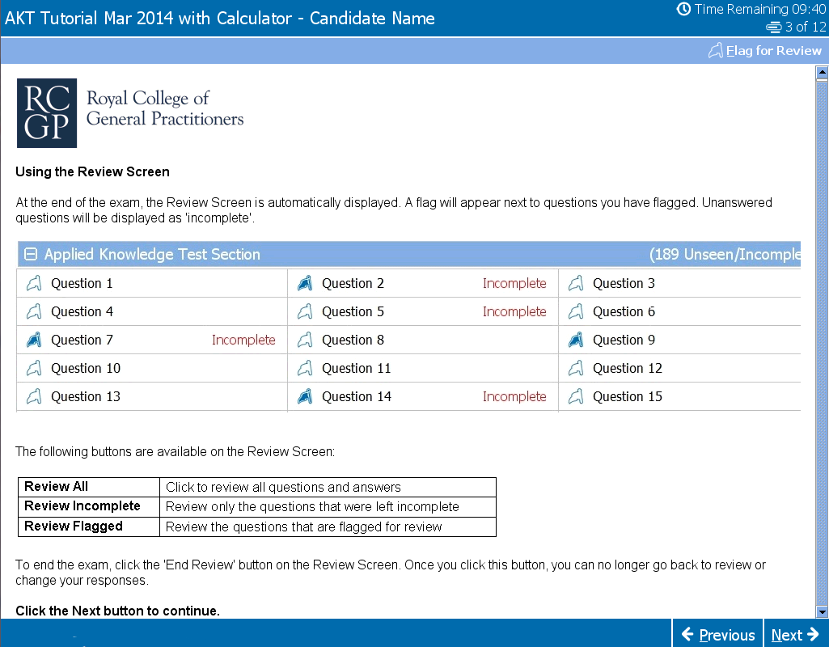
Test Day Tutorial:
Using the review screen

Slide 68
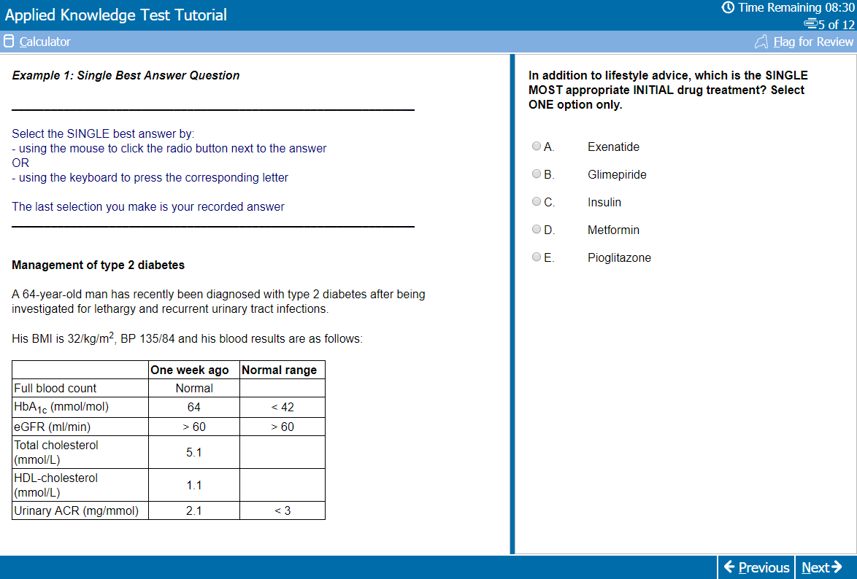
Test Day Tutorial:
SBA question example

Slide 69
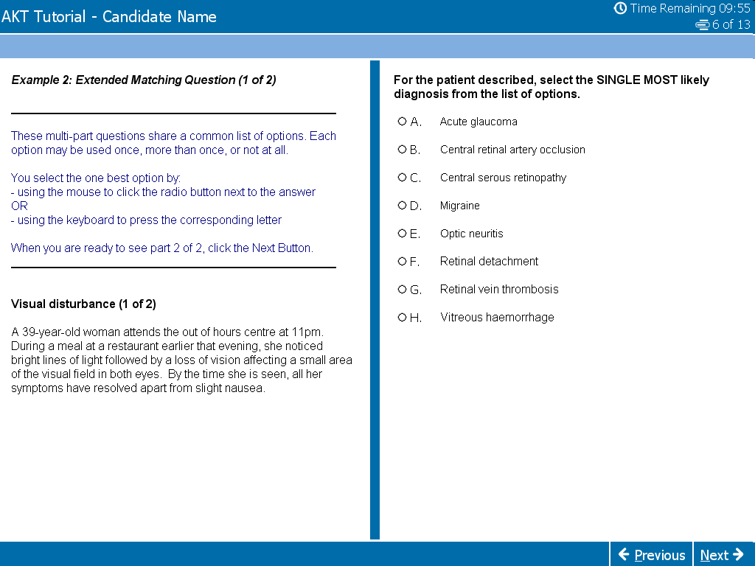
Test Day Tutorial:
EMQ question example

Slide 70
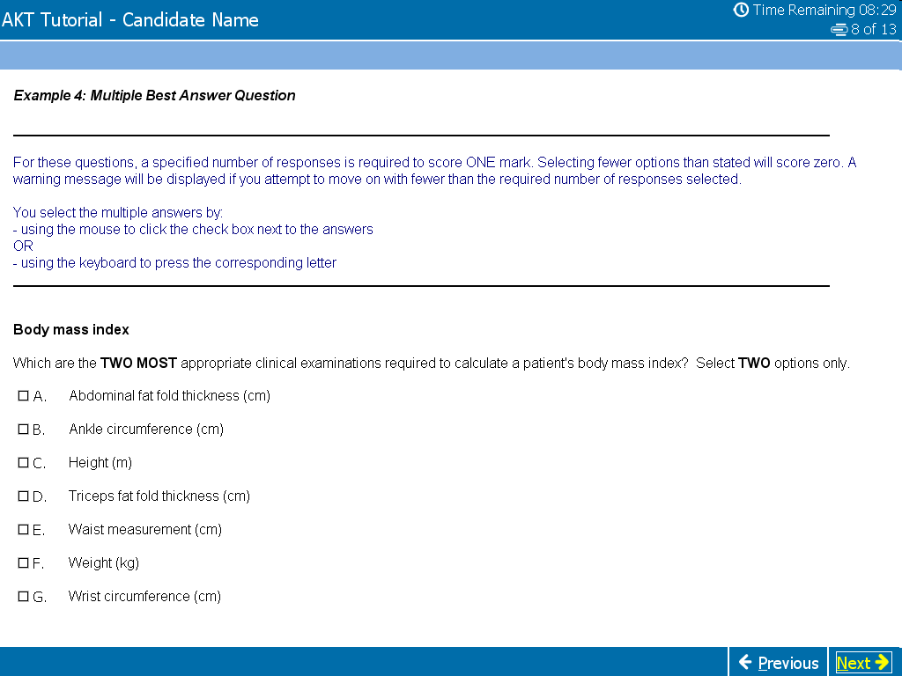
Test Day Tutorial:
MBA question example

Slide 71
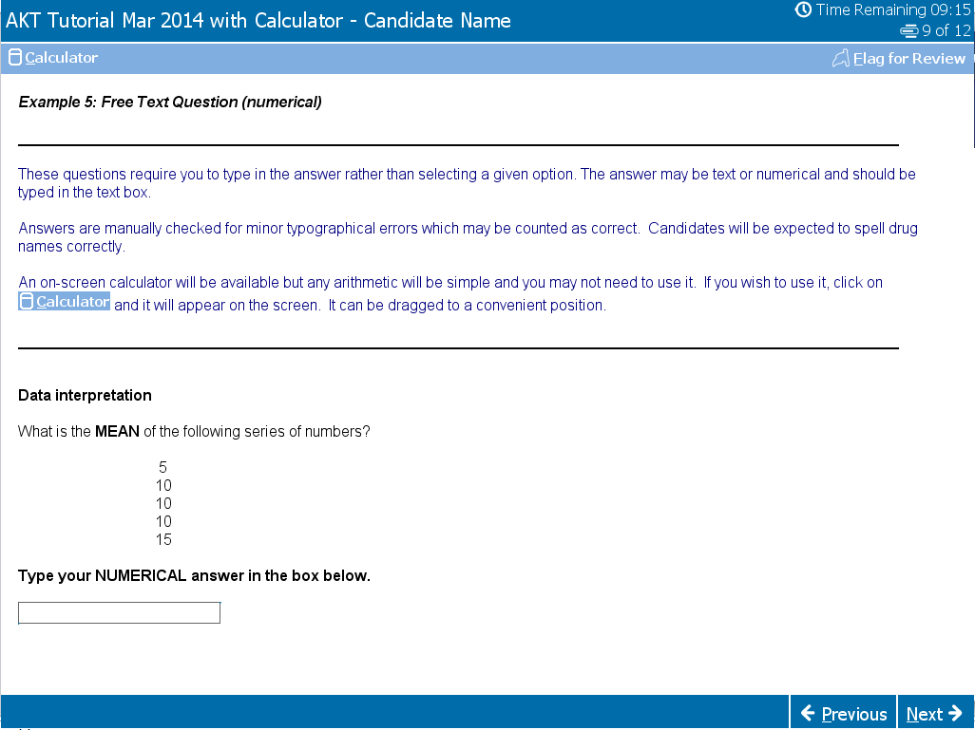
Test Day Tutorial: Free Text question example (including calculator)

Slide 72
Exam technique 1
Time management – this is everything
Keep watching the countdown clock on the computer
200 questions in 3 hours 10 minutes = an average of 57 seconds per question
You should skip questions you find difficult rather than waste time. Electronically ‘flag for review’ the ones you have left out but don’t forget to leave time to go back before the end

Slide 73
Exam technique 2
Cover test – can you answer the question with the option list covered? If so, it’s probably the correct answer
Go through unanswered questions 2nd time round using the review facilty
Do not leave any questions unanswered – educated guessing is worthwhile
Check for silly mistakes if you still have time

Slide 74
Exam technique 3
All the AKT question formats, apart from the free text, require the candidate to identify the best answer(s) from a given list of plausible alternatives, using all of the information in the question
There may be other answers which are not included in the option list, but you have to focus on the best available answer listed for the specific question asked

Slide 75
Further preparation
Small (online?) revision groups share the workload: review national guidance, BNF etc.
Learn from clinical experience – check the guidelines and references.
AKT Exam website feedback (feedback reports published for every AKT sitting and the 5-year summary)
AKT Exam website podcast, preparation guide and sample material
RCGP eLearning website – Essential Knowledge Updates and Challenges, as well as GP Self Test to help identify educational needs for more specific revision planning

Slide 76
And finally….
Remember that most people can pass this exam…..
But you do need to be organised, plan ahead and prepare well for it
Do make effective use of the RCGP Curriculum Knowledge and Skills guides and don’t overlook the super condensed guides

