Slide 1
EoL Educational Package 4 – Lesson 1: Personalised Care and Support Planning (PCSP)
September 2019

Slide 2
Lesson 1
Aim: To demonstrate clarity about what Personalised Care and Support Plan (PCSP) is, and is not, and how this fits with other palliative and end of life care-related planning tools, e.g. ReSPECT, Advance Care Planning (ACP), etc.
Content:
Why is care planning important?
Definition of PCSP
Demonstrate how fits in with other End of Life (EoL) planning tools

Slide 3
Why is taking a personalised approach to care planning important?
Notes:
This is Max. Max died from bowel cancer a number of years ago. In his working life he was part of an international community of people who used person centred approaches in his day to day work. As he neared the end of his life he was determined to show how important it is to take a personalised approach with people at the end of their lives. This film and others he made, are his legacy.

Slide 4
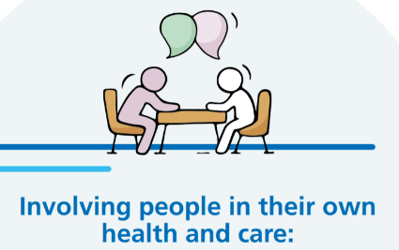
Why involve people in their own health and care?
National surveys tell us that over 40% of people want to be more involved in decisions about their care. Similarly 40% of people living with long term conditions want more support to manage their health and wellbeing on a day to day basis.
By involving people in decisions about their health and care we will improve health and wellbeing, improve the quality of care and ensure people make informed use of available healthcare resources.
Personalised care and support planning is a systematic way of ensuring that individuals living with one or more long term condition are supported through proactive conversations, with their clinician or health and care professionals. These conversations should focus on what matters most to that individual (their personal goals) and the support they need to manage their health and wellbeing. It should be a process of sharing information, identifying medical and non-medical support needs, discussing options, contingency planning, setting goals, documenting the discussion and monitoring progress through regular review.

Slide 5
Definition of PCSP
Personalised Care and Support Planning is a series of facilitated conversations in which the person, or those who know them well, actively participates to explore the management of their health and well-being within the context of their whole life and family situation.
The process recognises the person’s skills and strengths, as well as their experiences and the things that matter the most to them. It addresses the things that aren’t working in the person’s life and identifies outcomes and actions to resolve these.
Notes:
This is NHSE&I’s definition of what is meant by personalised care and support planning. The two words highlighted relate to what are the fundamentals of the approach as shown in the next slide.

Slide 6
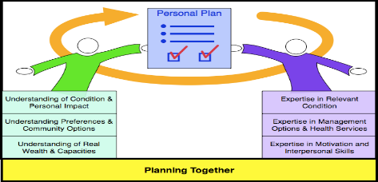
Fundamentally it’s about……….
A different conversation, starting with what matters
And recognising people as equals and experts in their own lives
&
Notes:
Though we have a definition of PCSP, to simplify it these are the two key messages the training needs to get across to people. Firstly, its about having a different conversation with people that starts with what matters to them, as well as what good support looks like at the end of their lives and shared decision making about treatment. Secondly, its about the approach that you take that recognises people as equal participants in planning and also recognises the expertise they bring about their life is equally as important.

Slide 7
Key Features - Perspective
Perspective – this is a way of ‘seeing people’ and attitude towards them that is fundamental to good Personalised Care and Support Planning.
The changed relationship and different conversation will mean that the person:
• is empowered and builds knowledge, skills and confidence.
• experiences hope and feels confident that the process and the plan will deliver what matters most to them.
• is central in developing their Personalised Care and Support Plan and will agree who is involved.
• is seen as a whole person within the context of their whole life, valuing their skills, strengths, experience and important relationships.
• is valued as an active participant in conversations and decisions about their health and well being.
Notes:
The key features were developed by the National strategic co production group, who are part of the Personalised Care Group at NHSE&I and are used by them as a checklist for whether the plan is personalised. They are divided into 3 sections: perspective, process & plan.

Slide 8
Key Features - Process
Process – this is the overall process of personalised care and support planning.
A good Personalised Care and Support Planning process will mean that the person:
• has the time and support to develop their plan in a safe and reflective space.
• is able to access information and advice that is clear and timely and meets individual information needs and preferences.
• feels prepared, knows what to expect and is ready to engage in planning supported by a single, named coordinator.
• is listened to and understood in a way that builds trusting and effective relationships with key people.
• is able to agree the health and well-being outcomes (and learning outcomes for children and young people with education, health and care plans) they want to achieve, in dialogue with the relevant health, education and social care professionals.
• has the chance to formally and informally review their personalised care and support plan.

Slide 9
Key Features - Plan
Plan – this is what a good plan looks like.
A Personalised Care and Support Plan:
• is a way of capturing and recording conversations, decisions and agreed outcomes in a way that makes sense to the person.
• should be proportionate, flexible and coordinated and adaptable to a person’s health condition, situation and care and support needs.
• should include a description of the person, what matters to them and all the necessary elements that would make the plan achievable and effective.

Slide 10
Long Term Plan (LTP) Metrics
Personalised Care and Support planning is one of 30 LTP metrics.
Paragraph 1.42 in the LTP states “With patients, families, local authorities and our voluntary sector partners at both a national and local level, including specialist hospices, the NHS will personalise care, to improve end of life care”. It continues “By rolling out training to help staff identify and support relevant patients, we will introduce proactive and personalised care planning for everyone identified as being in their last year of life”.
The count includes the total number of personalised care and support plans (new PCSP completed or existing PCSP reviewed) during the financial year to date.
Notes:
.It has been announced that personalised care and support plans will be one of 30 metrics collected as part of the implementation of the long term plan. The criteria on the next slide have been developed to help people with the count whilst ensuring the quality of the plans counted remains.

Slide 11
5 Key Criteria
The 5 areas below are the key criteria for counting PCSPs. All 5 of these criteria need to be in place for a local PCSP to be counted.
People are central in developing and agreeing their personalised care and support plan including deciding who is involved in the process.
People have proactive, personalised conversations which focus on what matters to them, paying attention to their needs and wider health and wellbeing.
People agree the health and wellbeing outcomes they want to achieve, in partnership with the relevant professionals.
Each person has a sharable, personalised care and support plan which records what matters to them, their outcomes and how they will be achieved.
People are able to formally and informally review their personalised care and support plan.
Notes:
These five criteria are a summary of the key features for PCSP and were developed to make it easier for people to see if the plans they are developing and therefore counting are of the right standard. Further technical guidance will be developed to support this.

Slide 12
How does PCSP fit into the Ambitions Framework?
I, and the people important to me, have opportunities to have honest, informed and timely conversations and to know that I might die soon. I am asked what matters most to me. Those who care for me know that and work with me to do what’s possible.
I live in a society where I get good end of life care regardless of who I am, where I live or the circumstances of my life.
I get the right help at the right time from the right people. I have a team around me who know my needs and my plans and work together to help me achieve them. I can always reach someone who will listen and respond at any time of the day or night.

Slide 13
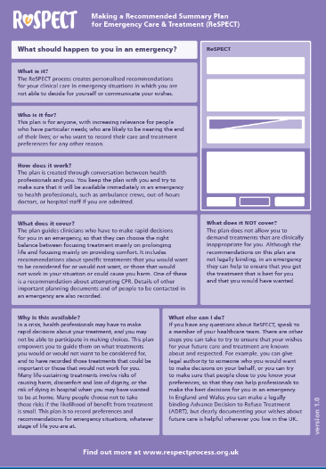
How PCSP fits in with other EoL planning tools
Notes:
Discussion – do existing care plans/ planning tools meet all 5 key criteria? Slides 13-15 are aids.

Slide 14
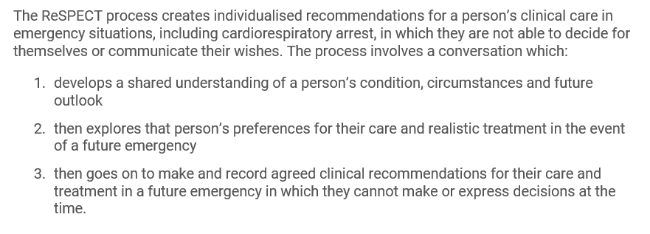
People are central in developing and agreeing their PCSP.
People have proactive, personalised conversations which focus on what matters to them.
People agree the health and wellbeing outcomes they want to achieve, in partnership with the relevant professionals.
Each person has a sharable personalised care and support plan.
People have the opportunity to formally and informally review their care plan.
Reference
Resuscitation Council (UK) - ReSPECT

Slide 15
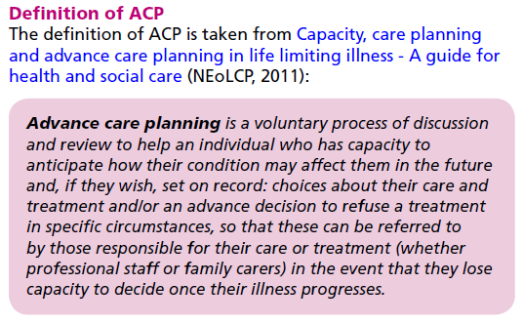
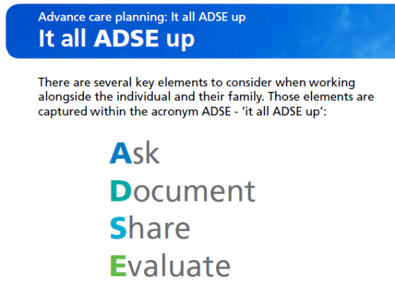
Advance Care Plan (ACP)
People are central in developing and agreeing their PCSP.
People have proactive, personalised conversations which focus on what matters to them.
People agree the health and wellbeing outcomes they want to achieve, in partnership with the relevant professionals.
Each person has a sharable personalised care and support plan.
People have the opportunity to formally and informally review their care plan.
Reference
NEoLC Improving end of life care – Advanced Care Planning: It all ADSE up

Slide 16
Electronic Palliative Care Coordination System (EPaCCS)
People are central in developing and agreeing their PCSP.
People have proactive, personalised conversations which focus on what matters to them.
People agree the health and wellbeing outcomes they want to achieve, in partnership with the relevant professionals.
Each person has a sharable personalised care and support plan.
? People have the opportunity to formally and informally review their care plan.
EPaCCS facilitates a structured care planning conversation.
EPaCCS aim to provide up-to-date key information about patients believed to be in the last year of their life in order to improve communication and coordination and ensure that all those involved in a patient's care are aware of their wishes, preferences and advance care plan.
A number of trusts offer printed copies of the information contained within EPaCCS to patients. Reviews normally occur after a significant change in the patients condition.
.
Reference
BMJ – Crash course in EPaCCS: 8 years of successes and failures in patient data sharing to learn from
The End of Life Partnership - EPaCCS
Notes:
Sharable - In practice GPs should be consenting the patient and talking to them about EPaCCS i.e. that information will be recorded in an electronic system and shared with other health care professionals.
Review – A number of trusts offer printed copies of the information contained within EPaCCS – detailed within locally produced consent to share leaflets. In practice very few patients request this and clinicians don’t proactively offer it as in practical terms working in the community we don’t have a printer with us to do it there and then and my worry is that as it gets frequently updated that the information in the paper copy could be out of date.

Slide 17
Key learning
PCSP conversations should be a process of sharing information, identifying medical and non-medical support needs, discussing options, contingency planning, setting goals, documenting the discussion and monitoring progress through regular review.
It is about a different conversation, starting with what matters and then recognising people as equals and experts in their own lives.
PCSP is one of 30 LTP metrics - the LTP stipulates that “proactive and personalised care planning will be introduced for everyone identified as being in their last year of life”.
PCSP is aligned to Ambitions 1, 2 and 4.
PCSP may encompass, but is not limited to, advance care planning. PCSP is essentially an umbrella term.
Lesson 2 aims to demonstrate skills and behaviours which enable the process of PCSP to be initiated and conducted in a way that is person-centred and supportive of the person.

