Slide 1
MRCGP
Applied Knowledge Test
Prepared by the AKT Core Group
May 2023
Notes:
1

Slide 2
Objectives
An overview of the content and structure
To give examples of current question formats
To describe how questions are constructed
To advise on how to prepare and pass the AKT
To explain practicalities of computer-based tests

Slide 3
AKT Background
The AKT:
  Is a summative assessment of the knowledge base underpinning independent UK general practice
  Tests the application of this knowledge
  Tests the critical interpretation of information
  Is mapped to the latest RCGP Curriculum updates
Each question is intended to explore a topic which an ordinary GP in the UK could be expected to have a working knowledge

Slide 4
Format
200-item multiple-choice test lasting 190 minutes (3 hours 10 minutes)*
  No multiple true/false questions
  No negative marking
Delivered on a computer terminal* at an invigilated test centre
Offered three times a year:
Jan/Feb, April/May, Oct/Nov
* Please see slide 53 and the RCGP website for information on reasonable adjustments

Slide 5
Rules
Applicable if starting specialty training from 1/8/10 onwards:
Only trainees in the ST2 and ST3 stages of training are eligible to take the AKT
A maximum number of four attempts will be permissible in the AKT but, due to COVID-19, a single unsuccessful attempt at either the July or August 2020 AKT did not count towards the total number of permitted attempts
In accordance with GMC guidance* an AKT pass is valid for seven years.
AiTs in training (includes TGPT, LTFT, on Maternity Leave) between 18 March 2020 and mid-June 2021 whose ability to study for and take the exam was affected by COVID-19 have the currency of their AKT extended to 7 years and 6 months.
* https://www.gmc-uk.org/education/postgraduate/9813.asp#Currency

Slide 6
Rules – exceptions
Applicable from 1/8/16 onwards, for those unsuccessful at AKT after 4 attempts:
In certain circumstances candidates are allowed to make exceptional fifth attempts at examinations based on additional educational attainment
Full details of this policy are available from the MRCGP webpages
For further information:
https://www.rcgp.org.uk/training-exams/mrcgp-exam-overview.aspx

Slide 7
Vital Statistics – Apr 2023
  AKT 48 pass mark = 139/200 (69.5%)
  Overall pass rate = 68.1%
  UK graduates first-time takers pass rate = 83.1%
  (Pass rates vary in different diets of the AKT taken at
  different times throughout the training year)
  The cumulative pass rate for all those who take the AKT is at least 95%
Notes:
7

Slide 8
Vital Statistics – Apr 2023
  Overall mean score = 145.6 (72.8%)
  Mean scores by subject area:
Subject area | Mean score (%) | No. of questions
Clinical knowledge | 73.0 | 160
Evidence-based practice | 70.6 | 20
Organisation and management | 73.5 | 20
Notes:
8

Slide 9
Topics causing most difficulty for candidates in AKT 48
Professional topics:
Improving Quality, Safety and Prescribing
  Prescribing antibiotics in line with national guidance
  Monitoring of drugs prescribed for mental health conditions
Leadership and management:
  Death administration and involving the coroner/ procurator fiscal
  Application of rules on data protection and confidentiality to use of social media
Clinical topics:
  Management of acne in line with national guidance
  Medically unexplained symptoms
  Urgent and unscheduled care and potential admission e.g. breathlessness
Notes:
9

Slide 10
Topics causing most difficulty for candidates in AKT 47
Professional topics:
Improving Quality, Safety and Prescribing
  Drug side-effects
  Antibiotic management of common clinical problems
Life stages topics:
Children and Young People
  Prescribing for long-term conditions in children
  Abnormal child development
People with long-term conditions (including cancer)
  Interpreting photographs of pre-cancerous (genital) lesions
Clinical topics:
  Eyelid problems
  Management of chronic asthma incl. stepping up Px and exacerbations
  Teratogenic drugs and contraception
Notes:
10

Slide 11
Topics causing most difficulty for candidates in AKT 46
Professional topics:
Leadership and management
  Privacy – including social media and digital technologies
Clinical topics:
  Calculations (respiratory values)
  Causes of erectile dysfunction
  Gastrointestinal and Urology:
    appropriate investigation of red flags
    consideration of alternative diagnoses
    avoiding over-investigation
  Pregnancy as an explanation of common symptoms
  Teratogenic drugs and contraception
Notes:
11

Slide 12
Summary of ‘professional topics’ causing most difficulty in recent AKT exams
  Some of these topics have been highlighted several times over recent years:
Consulting in General Practice:
    Communication of risk and use of risk tools
Evidence-based practice, Research and Sharing Knowledge:
    Basic understanding of concepts and terms in research (e.g. absolute and relative risk)
    Data interpretation (both research and other data sources)
    Research methodology
Improving Quality, Safety and Prescribing:
    Antibiotic indications, guidance, and resistance
    Drugs: monitoring; adverse reactions*;interactions; (dose calculations)*; end-of-life care
    Safe prescribing and medicines management (including MHRA alerts)
Leadership and management:
    Confidentiality and privacy (including social media and digital technologies)
    Death certification and notifications to Coroner/ Procurator fiscal
    Staff health, and health and safety in the workplace
  * Recently improved (AKT 46-48)
Notes:
12

Slide 13
Summary of other topics causing most difficulty in recent AKT exams
  Life stages topics:
    Children and Young People including consent and capacity; developmental assessment and screening; safeguarding and non-accidental injury
    People at the End-of-Life including ethics, pain management, and mental capacity
Clinical topics:
    Cardiovascular health including: diagnosis, ECG interpretation; reducing risk
    Common gynaecological problems incl. timely pregnancy testing
    Contraception (incl. use with teratogenic drugs) and HRT
    Diagnosis of common oral conditions
    Different presentations of multi-system disease
    Eye and eyelid problems
    Mental health – presentations with physical symptoms; substance abuse
    Neurological diagnosis, red flags, and interpretation of examination findings
    Normal findings, minor illness, and infections in childhood
    Respiratory medicine: asthma, COPD and rarer diagnoses; interpreting spirometry
    Suspected cancer: diagnosis & investigation (including less common presentations)
    Timely but appropriate referral (including emergencies and when to do nothing)
    Prescribing in diabetes, including insulin
A Five-year summary is also available on the AKT website
Notes:
13

Slide 14
Question writing (1)
Topical
Practice issues
Scenarios derived from clinical work

Slide 15
Question writing (2)
All questions are referenced and the draft questions are then carefully scrutinised by a panel of experienced question writers
Care is taken to consider any conflict between national guidance and regulations across the four devolved nations
Remember that all question writers are working GPs

Slide 16
Common Reference Material (1)
GMC Good Medical Practice
NICE guidelines
SIGN guidelines
CKS (NICE clinical knowledge summaries)
BMJ Review articles & original papers
BJGP
Cochrane
Vaccine update (www.gov.uk) / Green Book

Slide 17
Common Reference Material (2)
BNF – including the initial ‘generic’ chapters in the print version
A recent review has recently highlighted that up to 27% of AKT questions require a knowledge of therapeutics
For example, although items might appear to be about a respiratory, cardiovascular or endocrine issue, the management will often involve recommending the correct medication – also requiring an awareness of the potential for interactions and monitoring requirements

Slide 18
GP Curriculum
Where to find
https://www.rcgp.org.uk/training-exams/training/gp-curriculum-overview.aspx
Curriculum summaries (can be useful to identify learning needs):
https://www.rcgp.org.uk/mrcgp-exams/gp-curriculum/super-condensed-guides
How the AKT links to the curriculum
Questions in the AKT sample across the breadth of the curriculum
The previous ‘AKT Content Guide’ has been subsumed within the GP Curriculum and details can be found in the Knowledge and Skills subsections of each Topic Guide

Slide 19
GP Curriculum
How to use the GP Curriculum
Don’t be put off by the lengthy list of topics!
Use the topic guides as needs assessment tools
Carefully review the sections relevant to:
  Organisation and management – including administrative, statutory, ethical and regulatory frameworks
  Evidence-based practice – including research, statistics and epidemiology

Slide 20
MRCGP AKT Exam website
Please look carefully at our website
https://www.rcgp.org.uk/training-exams/mrcgp-exam-overview/mrcgp-applied-knowledge-test-akt.aspx
The ‘How to prepare for the AKT’ section contains helpful resources, including:
  ‘Preparing to take the AKT’ pdf
  50 AKT Sample questions with answers
  How trainers can help with AKT preparation
  Evidence and data interpretation in the AKT
  AKT FAQs
  Re-sitting the AKT (new November 2022)
The section ‘AKT Feedback Reports’ contains specific feedback on previous exams and should help guide your revision plans

Slide 21
Exam Construction ensures:
Reliability, validity, and fairness
Adequate coverage of the topics that appear in the blueprint
The correct balance of question formats

Slide 22
Principles of exam construction
Relevance: the AKT should be relevant to general practice
High prevalence: any topic covered can be one which occurs commonly
High impact: any topic covered can be one that is significant but less common

Slide 23
AKT content
  80% of questions
  Core clinical medicine and its application to problem solving in a general practice context
10% of questions
  Data interpretation, critical appraisal, and evidence based clinical practice
10% of questions
  Ethical and legal issues as well as the organisational structures that support UK general practice

Slide 24
Clinical Medicine (1)
The broad topic of clinical medicine is subdivided into groups of body systems, in approximately equal numbers
Each group will comprise questions on:
  disease factors
  symptoms
  investigation
  management

Slide 25
Clinical Medicine (2)
  Cardiovascular
  Dermatology
  Endocrinology
  ENT
  Gastroenterology
  Genetics
  Haematology
  Immunology
  Infection
  Mental health & learning disability
  Musculo-skeletal
  Neurology
  Ophthalmology
  Paediatrics
  Renal
  Reproductive male/female
  Respiratory
  Therapeutic indications and adverse reactions

Slide 26
Clinical Medicine (3)
Common, (mostly) low impact – e.g. sore throat, contraception, irritable bowel syndrome
Rare, high impact – e.g. child abuse, meningitis, phaeochromocytoma
Topical – e.g. guidance, COVID-19, optimum use of antibiotics
Notes:
26

Slide 27
Critical appraisal and evidence-based clinical practice
Understanding the principles of audit and its application in assessing the quality of care
Understanding the application of critical appraisal skills which will be tested in a number of formats including:
  interpretation of data commonly seen by GPs, including methods and results from published research
  understanding of common terms used in both evidence-based medicine and statistics
  understanding epidemiology relevant to general practice

Slide 28
Critical appraisal and evidence-based clinical practice
We use a range of resources to test data interpretation, including the types of graphs and tables regularly sent to practices from local health service organisations and health boards.
We would encourage you to use the following 2019 resource, produced by the AKT group:
https://www.rcgp.org.uk/training-exams/mrcgp-exam-overview/-/media/B4406D5D2E9A492B86AD74BC3FEFD08B

Slide 29
Ethical, Legal & Organisational
These questions are written to be applicable UK-wide
  NHS organisation
  Legal aspects e.g. DVLA
  Medical certification e.g. death certificates
  Professional regulation, e.g. GMC
  Business aspects e.g. GP contract
  Prescribing e.g. Controlled drugs
  Appropriate use of resources e.g. drugs
  Health & Safety e.g. needlestick injury
  Social services e.g. safeguarding
  Ethical e.g. Mental capacity, consent
Notes:
Content Guide Chapter +++

Slide 30
Question Formats
Single Best Answer (SBA)
Multiple Best Answer (MBA)
Extended Matching Questions (EMQ)
Photographic image
Data interpretation
Free text
Drug calculation

Slide 31
Single Best Answer (SBA)
“According to national guidelines” means recommended by nationally accepted guidelines or the BNF, not local practice
Often use a clinical scenario
Only one answer is correct
Other incorrect options may be plausible but not “most likely/most appropriate”

Slide 32
SBA example: Respiratory disease
A 41-year-old man has a chronic cough and expectorates green sputum daily. He has a history of recurrent chest infections in childhood.
Which is the single most likely diagnosis? Select one option only.
A. Asthma
B. Bronchiectasis
C. Chronic obstructive pulmonary disease
D. Gastro-oesophageal reflux
E. Lung cancer

Slide 33
Multiple Best Answer (MBA)
Often uses a clinical scenario
Two answers are correct
Both answers must be chosen to score one mark
Other options may be plausible but not the “most likely/most appropriate”

Slide 34
MBA example: Helicobacter pylori
A 35-year-old man has persistent dyspepsia. A stool test for Helicobacter pylori is positive. He has not yet received any antibiotic treatment and is allergic to penicillin.
According to current national guidance, which are the two most appropriate first-line antibiotics to combine with omeprazole to eradicate H.pylori? Select two options only and both must be correct to score one mark.
(See next slide)

Slide 35
MBA example: Helicobacter pylori
Amoxicillin
Cefalexin
Clarithromycin
Co-amoxiclav
Doxycycline
Erythromycin
Lymecycline
Metronidazole

Slide 36
Extended matching questions (EMQ)
These questions have a list of possible options
There will usually be two or more scenarios
Choose the most likely/most appropriate option that best matches each given scenario
Each option can be used once, more than once, or not at all

Slide 37
EMQ example: Dietary advice
Elemental diet
FODMAP
Food elimination
Gluten-free
High fibre
Lactose-free
Low purine
Mediterranean
For the patient described, select the most appropriate diet from the list of options.
1. A 23-year-old woman has had mild diarrhoea, abdominal pain and bloating for several years. Her bloods are normal, including IgA anti-tTG antibodies test.

Slide 38
EMQ example: Dietary advice
Elemental diet
FODMAP
Food elimination
Gluten-free
High fibre
Lactose-free
Low purine
Mediterranean
For the patient described, select the most appropriate diet from the list of options.
2. A 62-year-old man has recurrent swelling of his great toe which responds to naproxen. He drinks 18 units of alcohol a week and his urate level is 540 μmol/L (Normal < 450 μmol/L).

Slide 39
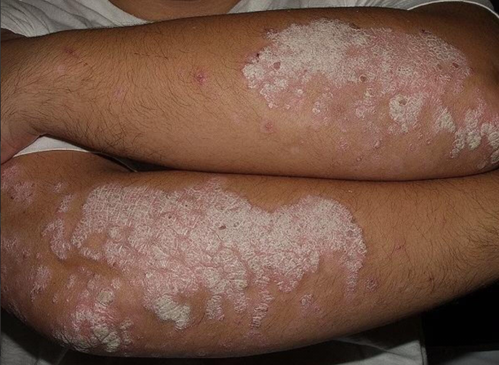
Picture Format example:
Skin disease
A 32-year-old man has a rash affecting both elbows.
He is using a topical emollient regularly.
pcds.org.uk

Slide 40
Picture Format example:
Skin disease
According to current guidance, in addition to emollients, which is the single most appropriate initial topical treatment? Select one option only.
Calcipotriol + betamethasone
Calcitriol
C. Fusidic acid + hydrocortisone
Mometasone furoate
E. Tacrolimus

Slide 41
Data Interpretation
Interpretation of data, e.g for groups of patients with chronic conditions
Interpretation of research and audit results
Understanding and application of common statistical terms, e.g number needed to treat (NNT) and absolute or relative risk

Slide 42
Data Interpretation example
Statins
The figure shows a meta-analysis of safety and efficacy outcomes for statins in the primary prevention of cardiovascular disease (CVD).
BMJ 2021;374:n1537 Fig 3

Slide 43
Data Interpretation example
Statins
According to the data shown, which is the single most accurate statistical description of the effects of statins? Select one option only.
A. Increased risk of diabetes
B. Increased risk of muscle disorders
C. Increased risk of stroke
D. Reduced risk of death from CVD
E. Reduced risk of liver dysfunction
Notes:
43

Slide 44
Free text questions
Require the candidate to generate the correct answer without a list of options to choose from
For example:
  dose calculation
  name of first-line medication
Eliminates guessing from a list of answers
All answers are screened manually to check for minor typographical errors which may be counted as correct.
Candidates will be expected to spell drug names correctly
Notes:
44

Slide 45
Free text example
A 67-year-old man has type 2 diabetes and a BMI of 33 kg/m². His HbA_{1c} is 62 mmol/mol on diet alone and his renal function is normal.
Which is the single most appropriate initial drug treatment? Give one answer only.
Notes:
45

Slide 46
Free text questions - numerical
An on-screen calculator is available
Any arithmetic required in an AKT question (e.g. drug dose calculations) is basic and simple and most candidates do not need to use it
Remember to check that your given answer is credible!
Notes:
46

Slide 47
Calculation example
A 3-year-old boy is to start prophylactic trimethoprim 2 mg/kg once every night. He weighs 12.5 kg and trimethoprim oral suspension is available as 50 mg/ 5ml.
What volume of liquid is required for thirty days use?
Type your answer in the following text box. Use figures
not words. Percentages and fractions are not acceptable.
mls
Notes:
47

Slide 48
Scoring
All question formats have equal weighting
Each correctly answered question is awarded one mark
Total score on the paper is the number of correct answers given
No negative marking – it is important to answer all the questions
Notes:
48

Slide 49
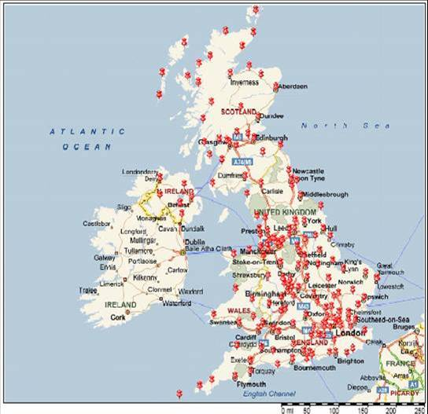
Computer Based Testing
Once candidates have applied via the RCGP website to sit the AKT, they are then directed to the Pearson VUE website to make their test centre booking.
There is a limited booking window with ‘first come, first serve’ choice of test session and venue.
There are approximately 150 test
centres covering all parts of the UK.
Notes:
49

Slide 50

Computer Based Testing Rules
Candidates must bring identity documents which match exactly their application details (see next slide)
Candidates should arrive in good time
Candidates who either arrive late or fail to provide matching ID, will not be admitted to sit the AKT

Slide 51
Identification documents to take to the test centre
  You need to take two documents.
  Both must be originals (not copies) and currently valid:
:
A primary ID
  Your primary ID must be government issued, and include your name, recent recognisable photo and signature (e.g. passport, photo driving licence)
A secondary ID
  Any ID containing at least a name and signature (e.g. credit and debit cards) or a name and recent recognisable photo that follows the ID requirements
  https://home.pearsonvue.com/Policies/1S/English
Notes:
51

Slide 52
Matching names on documents
The first and last name shown on both of your identification documents must match exactly the names you used when submitting your application to the RCGP.
If the names are different:
  For example, if one is your maiden name and one your married name then you must also bring an original official document that links the two names (e.g. a marriage certificate).
If in doubt:
  You must contact the RCGP well before the exam date.
Notes:
52

Slide 53
Reasonable adjustments
The RCGP has a duty to ensure equality and fairness to candidates and patients
If you have a disability or specific need which requires an adjustment to your exam, please consult the MRCGP RA page of the RCGP website for further information in the first instance
All requests for adjustments should be submitted by the deadline defined on the RA page of the RCGP website
In order to aid the RCGP in providing your approved reasonable adjustment, early booking is recommended (separate individual test rooms are limited)
Please note that approved additional time is added to afternoon sessions. Any recommended rest breaks are included in this time, so the timings of breaks need to be carefully managed by candidates
Notes:
53

Slide 54
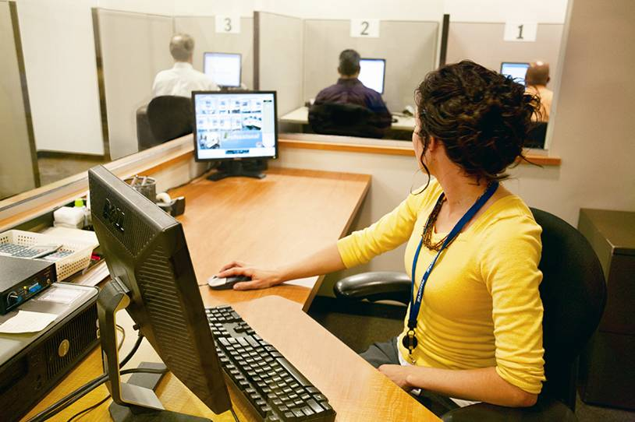
Computer Based Testing
Security at each centre will be robust:
  Identity checks
  Invigilated
  Video monitoring
Separate morning and afternoon sittings with a ‘quarantine’ period at lunchtime.
Morning candidates will not be allowed to leave before the end of the test

Slide 55
Computer Based Testing
It is strongly recommended that candidates familiarise themselves with the demonstration tutorial on the Pearson VUE website
  http://www.pearsonvue.com/rcgp/
Every AKT will begin with a short tutorial to remind candidates how to select answers and ‘mark’ questions – screen shots follow of the live tutorial
Notes:
55

Slide 56
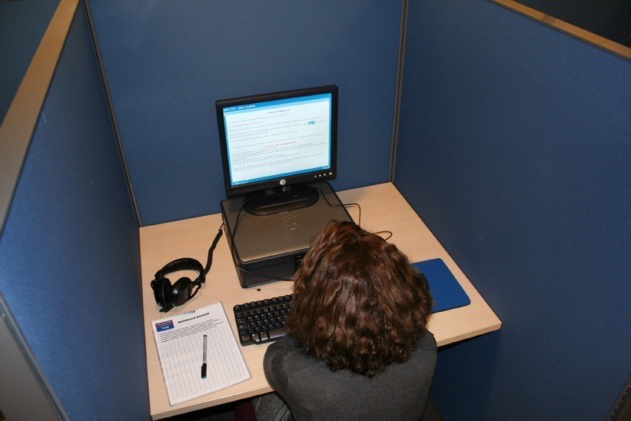
Computer Based Testing
Responses will be uploaded to a central server and then passed to the RCGP for post-test analysis

Slide 57
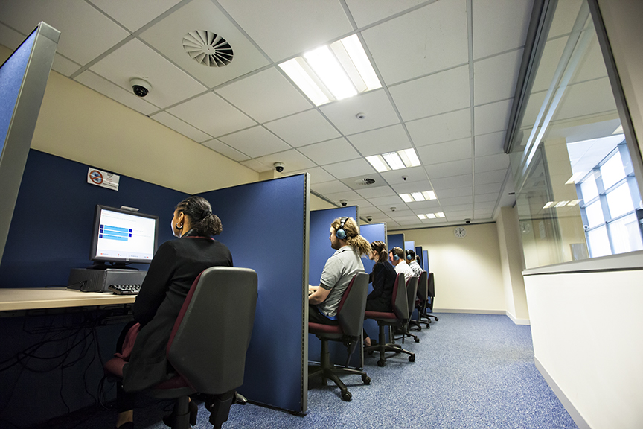
Computer Based Testing
Results and feedback will be sent individually to the candidate’s ePortfolio and will be available by the end of the day on the published results date

Slide 58
Feedback to candidates
The following feedback will be provided to every candidate with their result
  Their overall score
  The pass mark
  Their performance in each of the three main subject areas
  The mean performance of the cohort overall and in each of the three main subject areas

Slide 59
AKT Feedback Reports
More general feedback on overall performance will continue to be forwarded to all UK deaneries/LETBs and saved on the RCGP website
It is helpful to look at these individual feedback reports and the Five-year summary report to identify topics which commonly cause difficulty:
  https://www.rcgp.org.uk/training-exams/mrcgp-exam-overview/mrcgp-applied-knowledge-test-akt.aspx

Slide 60
AKT tutorial
At the test centre, before starting an AKT exam, all candidates have to complete a 10-minute Pearson VUE tutorial comprising example clinical questions.
These are not part of the exam and are not marked
The following slides show example screenshots from the pre-exam Tutorial, but this can be viewed in advance, in its entirety, from a link on the AKT exam webpages

Slide 61
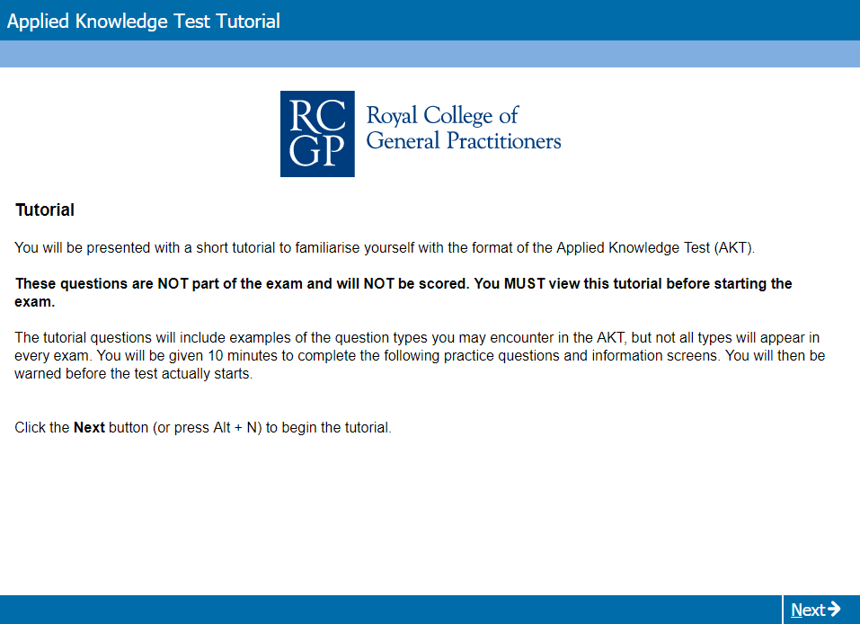
Online AKT Tutorial
Notes:
61

Slide 62
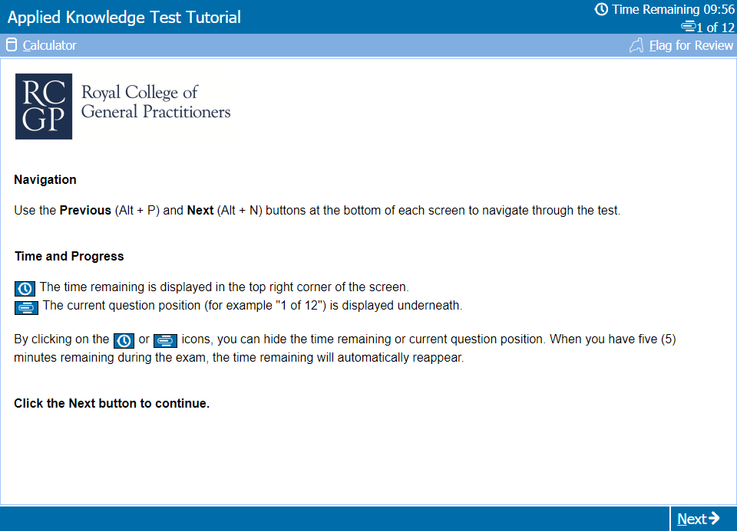
Test Day Tutorial: Opening Screen

Slide 63
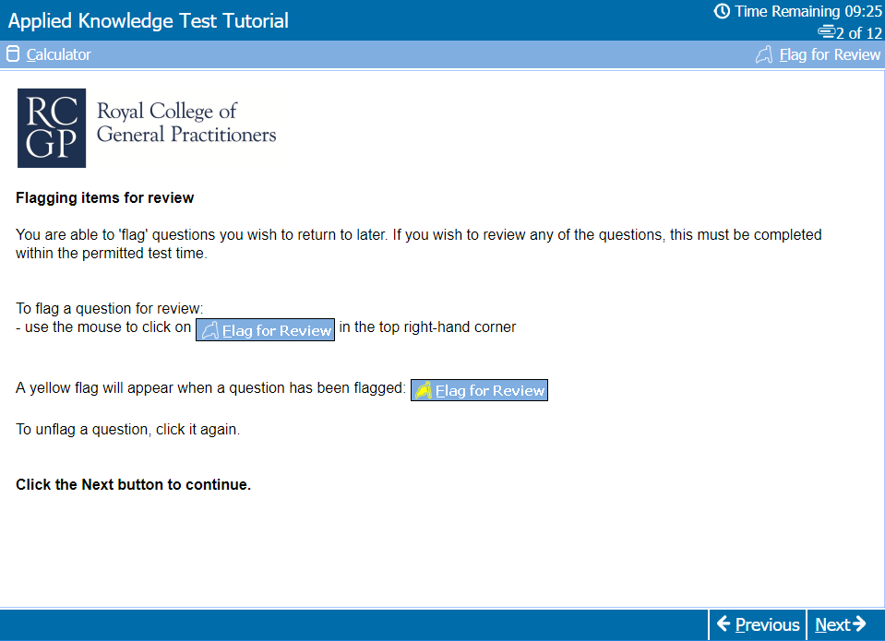
Test Day Tutorial:
Flagging questions for later review

Slide 64
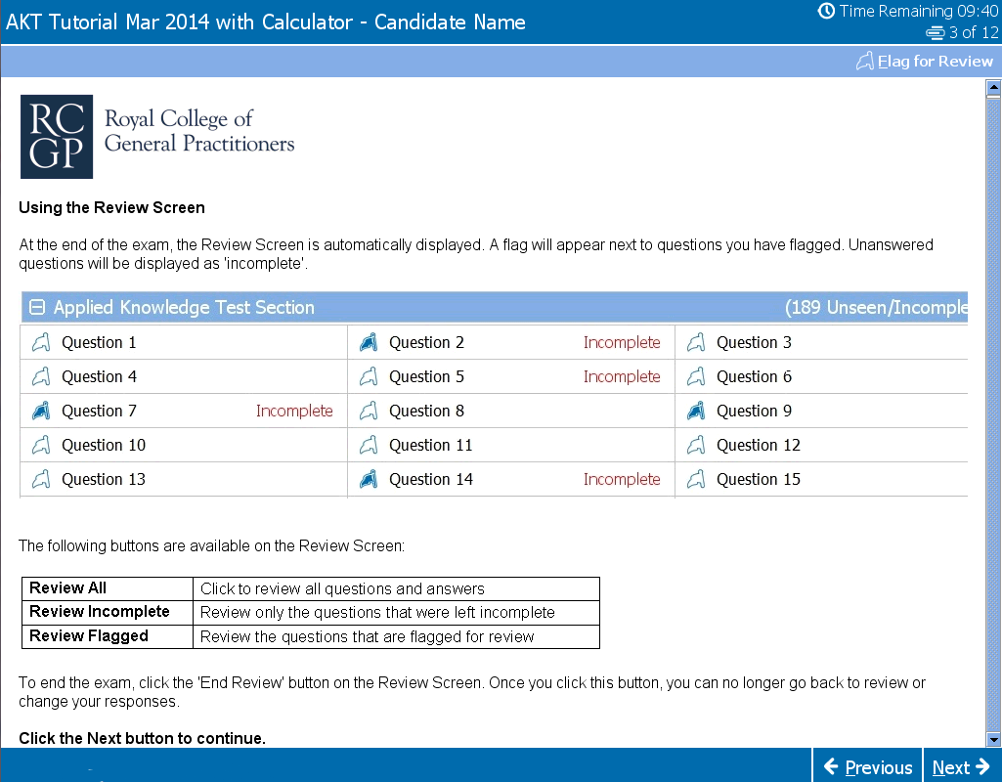
Test Day Tutorial:
Using the review screen

Slide 65
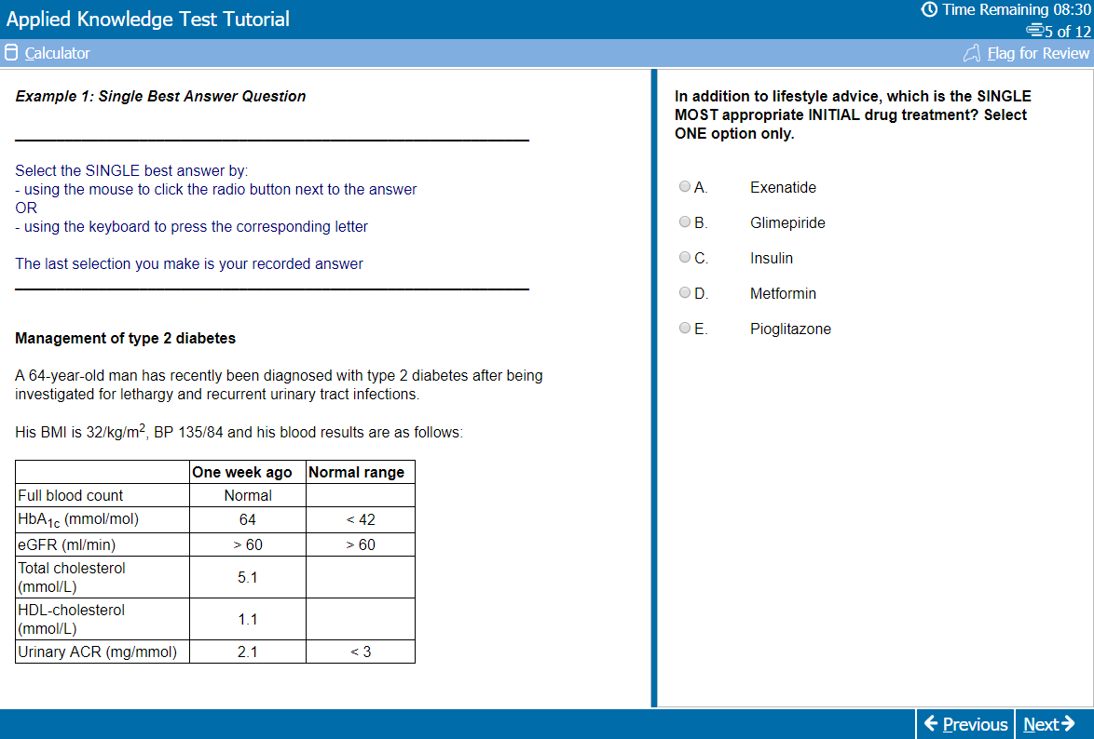
Test Day Tutorial:
SBA question example

Slide 66
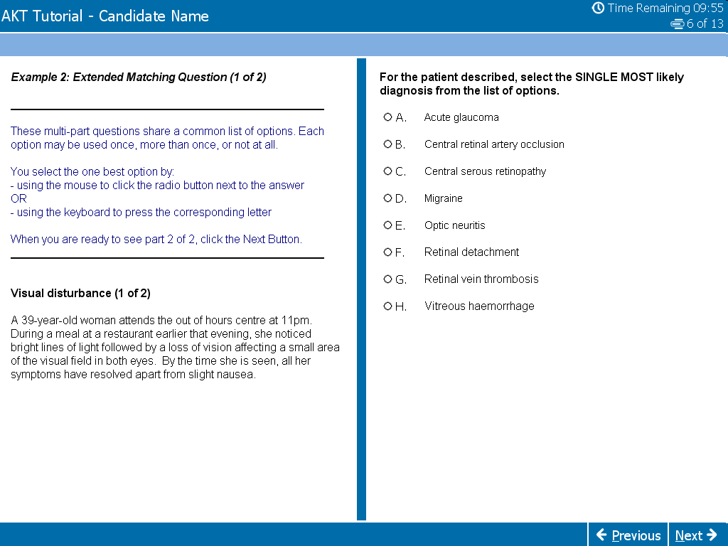
Test Day Tutorial:
EMQ question example

Slide 67
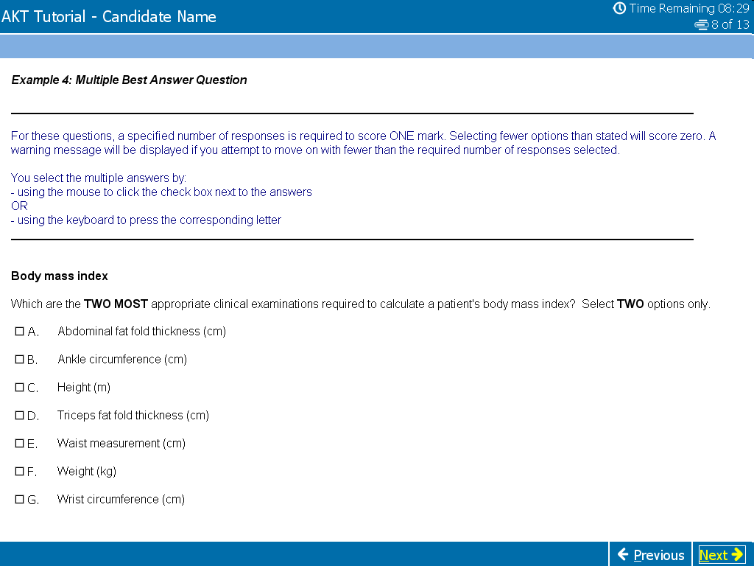
Test Day Tutorial:
MBA question example

Slide 68
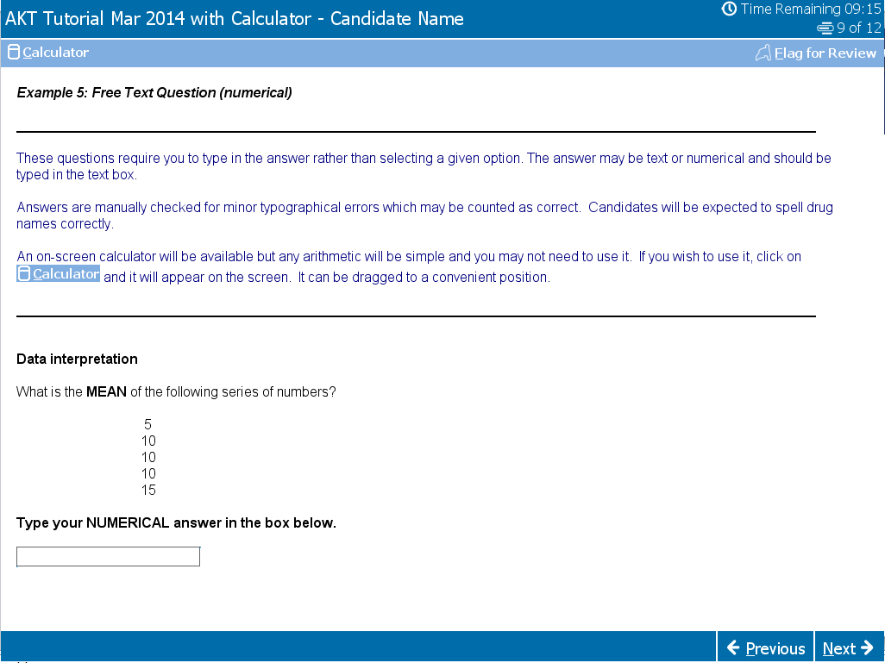
Test Day Tutorial: Free Text question example (including calculator)

Slide 69
Exam technique 1
Time management – this is everything
Keep watching the countdown clock on the computer
200 questions in 3 hours 10 minutes = an average of 57 seconds per question
You should skip questions you find difficult rather than waste time. Electronically ‘flag for review’ the ones you have left out but don’t forget to leave time to go back before the end

Slide 70
Exam technique 2
Cover test – can you answer the question with the option list covered? If so, it’s probably the correct answer
Go through unanswered questions 2nd time round using the review facilty
Do not leave any questions unanswered – educated guessing is worthwhile
Check for silly mistakes if you still have time

Slide 71
Exam technique 3
All the AKT question formats, apart from the free text, require the candidate to identify the best answer(s) from a given list of plausible alternatives, using all of the information in the question
There may be other answers which are not included in the option list, but you have to focus on the best available answer listed for the specific question asked

Slide 72
Further preparation
Small (online?) revision groups share the workload: review national guidance, BNF etc.
Learn from clinical experience – check the guidelines and references.
AKT Exam website feedback (feedback reports published for every AKT sitting and the 5-year summary)
AKT Exam website podcast, preparation guide and sample material
RCGP eLearning website – Essential Knowledge Updates and Challenges, as well as GP Self Test to help identify educational needs for more specific revision planning

Slide 73
And finally….
Remember that most people can pass this exam…..
But you do need to be organised, plan ahead and prepare well for it
Do make effective use of the RCGP Curriculum Knowledge and Skills guides

