Slide 1
LIFE AS A GP
NAME
Notes:
The design of these slides matches the ‘branding’ of the College’s ‘school engagement’ material including the ‘5 fantastic reasons to be a GP’ flyer. Suggested script is provided throughout. Delivering this presentation to a school group meets Gatsby Careers Guidance point 5 ‘encounters with employers’ which many schools now adhere to. It has also been designed with school Personal, Social and Healthcare curriculum in mind.
The objectives generally are:
to explain the difference between primary and secondary care
to describe the responsibilities of a GP
to inform pupils of some of the realities of medicine.
The estimated time for delivering these slides is 15 minutes but may be longer depending on the examples used. The content is suitable for pupils aged 13-18. A video is included - remove slide 5 if you do not have access to speakers. Slide 10 and 17 are ‘unlocked’ for adaptation by presenter. For longer sessions combine these slides with ‘Who wants to be a general practitioners quiz’ or other slides found at rcgp.org.uk/discovergp. To merge slides from two different presentations - click the arrow of ‘New Slide’ select ‘reuse slides’ ‘browse’ find the other presentation, be sure to tick the box ‘keep source formatting’ before selecting the slides you wish to add.
Suggested script: Hi My name is [x] I am a GP in [practice or locality]
GP stands for General Practitioner. I am a doctor in a practice with [x] number of other doctors and team members, and [x] number of patients registered.

Slide 2
Notes:
Notes:
The PSHE (Personal, Social, Health Education) association have found that pupils react positively when visitors present scenarios which they can clearly relate to. Consider examples to use about primary and secondary care which young people would be familiar with - and avoid shock tactics.
Suggested script:
When you require medical assistance in the UK you have two main options - primary or secondary healthcare.

Slide 3
Notes:
Notes:
The objectives are not to impress or shock pupils - this has been proven to be counter effective.
By starting straight away with the realities of medicine this should catch the pupils attention, and for older groups, understanding the realities of medicine is a necessary component of applying to study medicine.
Suggested script:
Today I want to talk to you about the life of a GP and specifically my life as a GP.
To do that I need to discuss some of the realities of medicine.
You may have an idea of what the job of a GP is but it tends to surprise people.
Every career path will have its challenges, and benefits and it is important you find out about these and consider them. Decision making is all about informed choices.
If you do decide to apply to study medicine an important element of the application process is being able to demonstrate that you understand the realities of medicine.

Slide 4
Notes:
Notes:
PSHE Health and Well-being core themes highlight that pupils need to see how career paths relate to their lives and to understand and appreciate the importance of workplace confidentiality and the data protection act.
Suggested script:
Most people want to feel proud of what they do and I am very proud that my patients place such trust in me.
Many of the patients I see day to day tell me things that they haven’t told their immediate family. They may have embarrassing symptoms or they may be worried and don’t want their family or friends to worry. This trust is a huge responsibility but it is also a privilege.
Aged 16-18 year old audience: Trust is also a huge component of the job of a GP because if my patients don’t trust that I will keep their information confidential they wont seek my help and this could be dangerous. Also - often much of a GPs ability to correctly diagnose is based on the patient providing all relevant information which they might not do if they don’t trust their doctor.

Slide 5
Notes:
Suggested script:
Lets watch a short video to look at the realities of what GPs face.
Link: https://www.youtube.com/watch?v=nVRpO8edaJQ&list=PLNZJMhpCZQ47mK3DYLpPeljDFaz64dfXu&index=1
If this link doesn’t work please search ‘Become an expert medical generalist, Discover GP’ in youtube.

Slide 6
Notes:
Suggested script:
The video you have just watched should start to show you what trust and confidentiality really look like in reality.
GPs diagnose, they treat and they prevent a huge variety of conditions.
But they also manage and treat the emotional side of the patient and must manage their expectations.
This is called ‘holistic care’ it means GPs consider the whole patient – which includes the physical, emotional, social, spiritual, cultural and economic aspects of wellbeing,
*Story tell here - provide a short, brief and clear example*

Slide 7
Notes:
Suggested script:
General practice is exciting because it has to continually adapt.
A GP consultation today is not the same as a GP consultation 10, 20 or 30 years ago. This can be challenging.
The rates of some diseases have fallen, but the number of consultations relating to stress have risen, the number of patients with knee and hip problems is increasing as the percentage of the population over the age of 65 has increased. Older patients now present with a number of issues at the same time which can be complex to decide how to manage.
One major change is the internet - people can look up their symptoms online. This can be a bad and a good thing. It can make patients come and see their doctor and it can stop them getting a doctors appointment because they think the issue isn’t serious.
As a result patients expectations have changed and so GPs have adapted and their training has developed… (continued on next slide).

Slide 8
Notes:
Suggested script:
Take a second to read this quote from a GP during a consultation with a patient who has been experiencing heart palpitations.
The patient is otherwise young and healthy therefore the GP is not concerned at this stage about other heart conditions.
What the GP is doing in this quote is explaining what they are thinking out loud to the patient. It is an example of how GPs are now trained - it is called person-centred care - including the patient in their decision making.
It also includes methods to communicate with patients and understand how much they understand about their own health, their symptoms and the human body - which can be challenging. This is called health literacy.
Story tell - provide an example here of health literacy.

Slide 9
Notes:
Suggested script:
Skills development is another benefit of becoming a GP:
GPs are trained to be expert generalists. As we have discussed they adapt to an ever changing world and must continue learning throughout their career.
You don’t become an expert in something and then that’s it - you must continue to use those skills to remain an expert - GPs use their skills every single day and so continue to grow and improve.
All jobs require a variety of skills. The skills to be a GP are very specific. Some doctors have little patient interaction.

Slide 10
A typical day:
8am - 11am 18 x ten minute consultations
11am - 2pm Review test results
Issue prescriptions
Arrange hospital admissions & referrals
Complete paperwork
Attend meetings
Lunch!
2pm - 5pm 18 x ten minute consultations or
Home visits or
Telephone consultations
Notes:
Suggested script:
So lets look at a GPs typical day and consider the skills required.
Notes:
This slide has been left ‘unlocked’ to allow for relevant adaption. Briefly run through your schedule with the group.

Slide 11
Notes:
Suggested script:
Within consultations GPs are dispensing medications, problem-solving, researching for answers, communicating, probing and more…
(continued on next slide)

Slide 12
Notes:
Notes:
PAUSE to allow audience to look at slide.
Suggested script:
But in order to get through the day and do all these things they have to navigate different patients and different factors.
Uncertainty is a major element of real life medicine and requires considering risk, asking colleagues for help and continually considering one of the four pillars of medical ethics - Non-maleficence - ‘to do no harm’
*provide an example here*

Slide 13
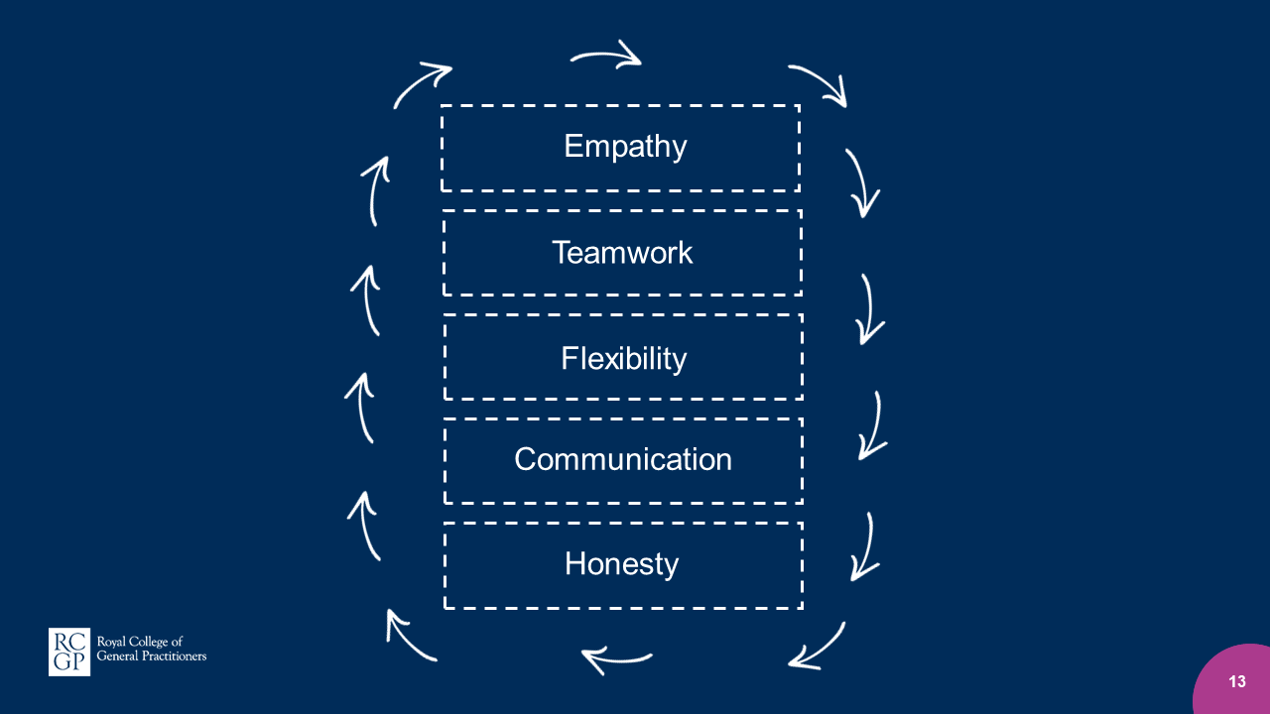
Notes:
Suggested script:
The way to navigate all these factors is through the development of expert skills and knowledge.
*provide examples*
Audience aged 16-18: To apply for medicine you need to understand what these skills look like in real life and you must be able to elaborate upon what they mean. It is not enough to say ‘doctors have to communicate well’ you have to explain which skills doctors - why they use them and how they do this in practice- you have to understand relevant terminology and be able to provide specific examples of when skills are used.

Slide 14
Notes:
Suggested script:
There is a common myth that GPs work in an isolated setting - that they are alone. But practices are made up of reception and admin staff who are crucial, pharmacists, physiotherapists and nurses and we must all support one another
*Provide a brief example of working as a team*.

Slide 15
Notes:
Suggested script:
The final benefit I am going to mention is that - GPs experiences can be very different.
GPs can work in small rural practices or large city practices - the types of patients and conditions they will see will be affected by the demographics of their local patient. *Explain demographics*
They can also develop what are called ‘portfolio careers’ they can work in the military, in sports, in teaching, in research.

Slide 16
Notes:
Notes:
Include here a brief outline of how and why you became a GP.
Evidence has proven that young people relate most to when adults admit the barriers they overcame or the insecurities. Acknowledge the difficulties faced.
It is preferable not to repeat the line that merely ‘hard work can get you where you wish to be’ - very often it is opportunities that make a difference i.e. family networks, courses or summer schools, individual teacher support, parental understanding etc. other factors matter and are not equal. Hard work is of course important but pupils should be encouraged to take opportunities where they can.

Slide 17
Flexibility
Insert image
Notes:
Notes:
PSHE health and wellbeing core theme - maintain ‘work life balance’ including understanding the importance of continuing with regular exercise and sleep.
It is important for young people to understand the significance of work/life balance or as we like to call it at RCGP, flexibility. Insert an image of your hobbies or your portfolio career and explain very briefly what you do to look after yourself - proving that GPs must do this too.

